Slide 1
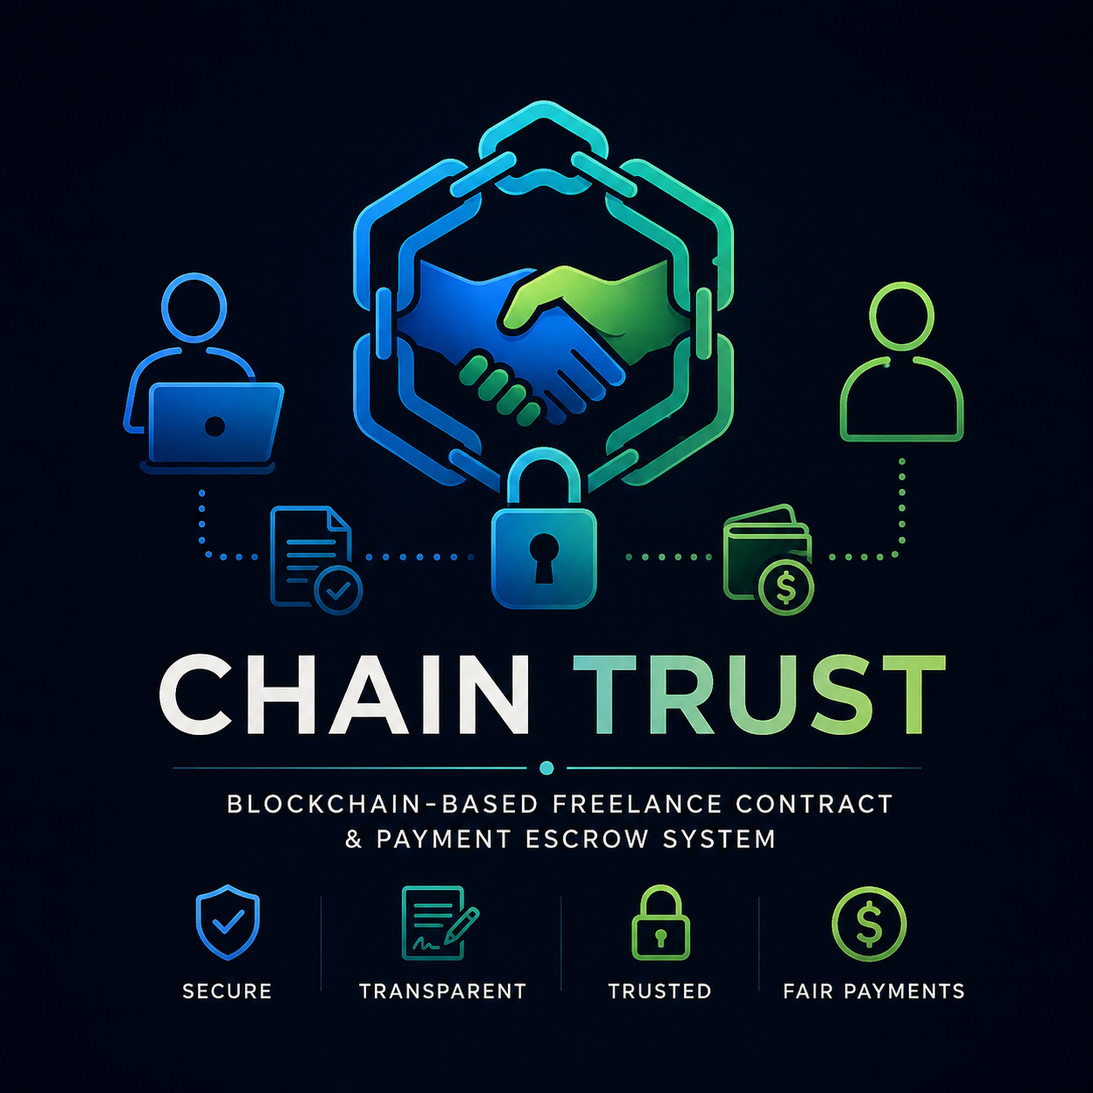
CHAIN TRUST
Blockchain-Based Freelance Contract
& Payment Escrow System
“Trustless contracts • Milestone escrow • Proof of delivery • Dispute transparency"
Team Name:
1. Aruthra V S
2. Bowyasri A
3. Abinaya R
College: Shrimati Indira Gandhi College
Software / Student Innovation
CHAIN TRUST • Blockchain-Based Freelance Contract & Payment Escrow
1

Slide 2
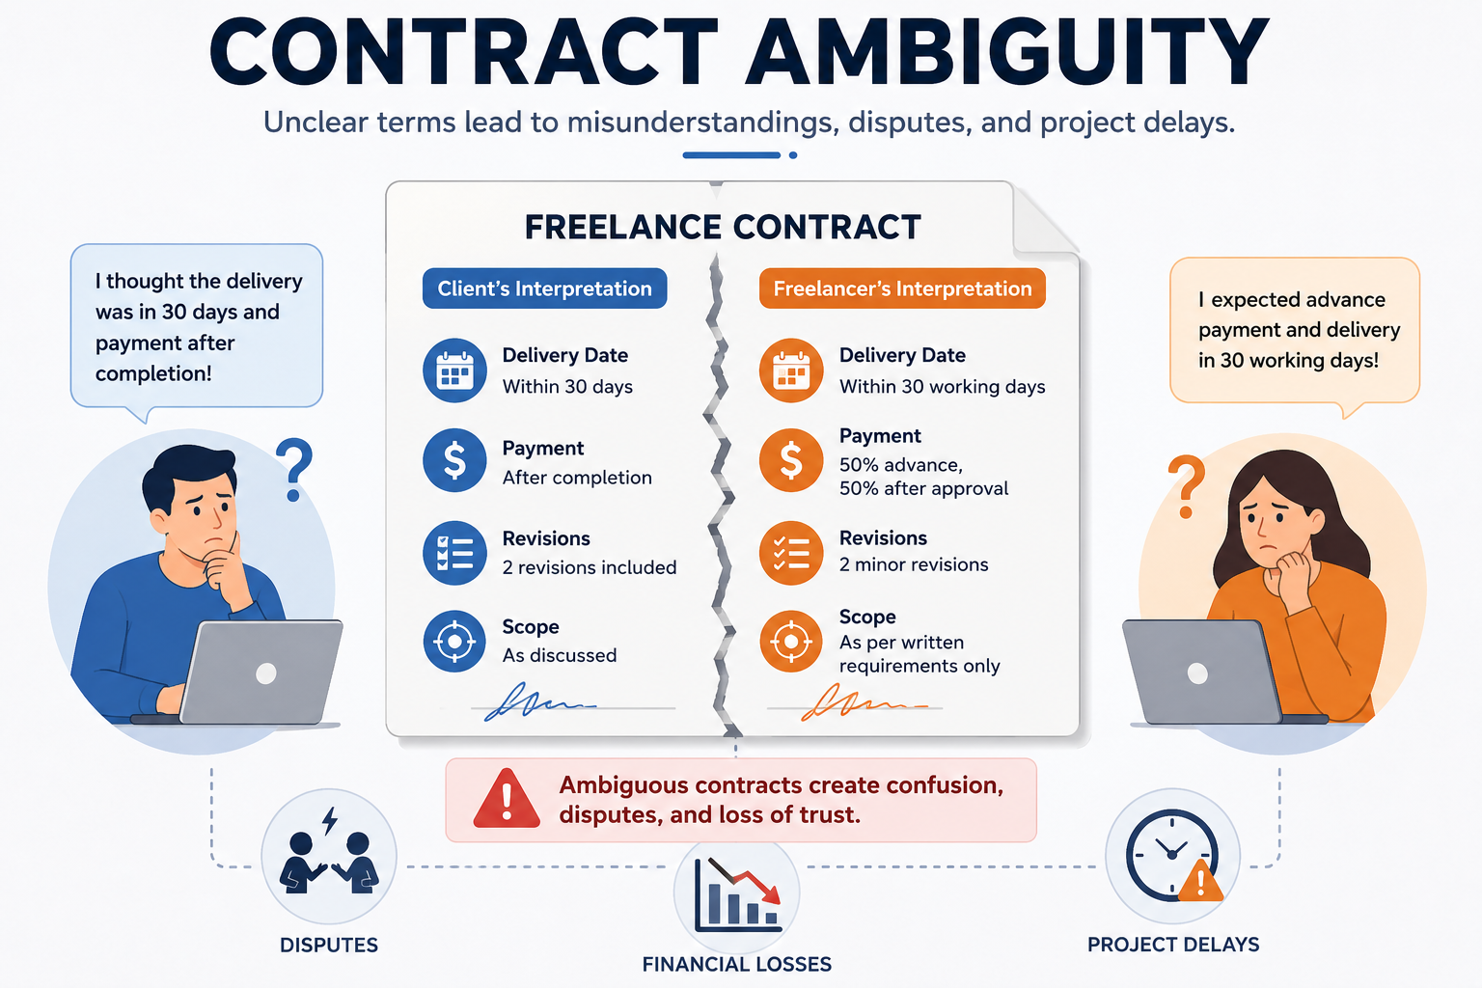
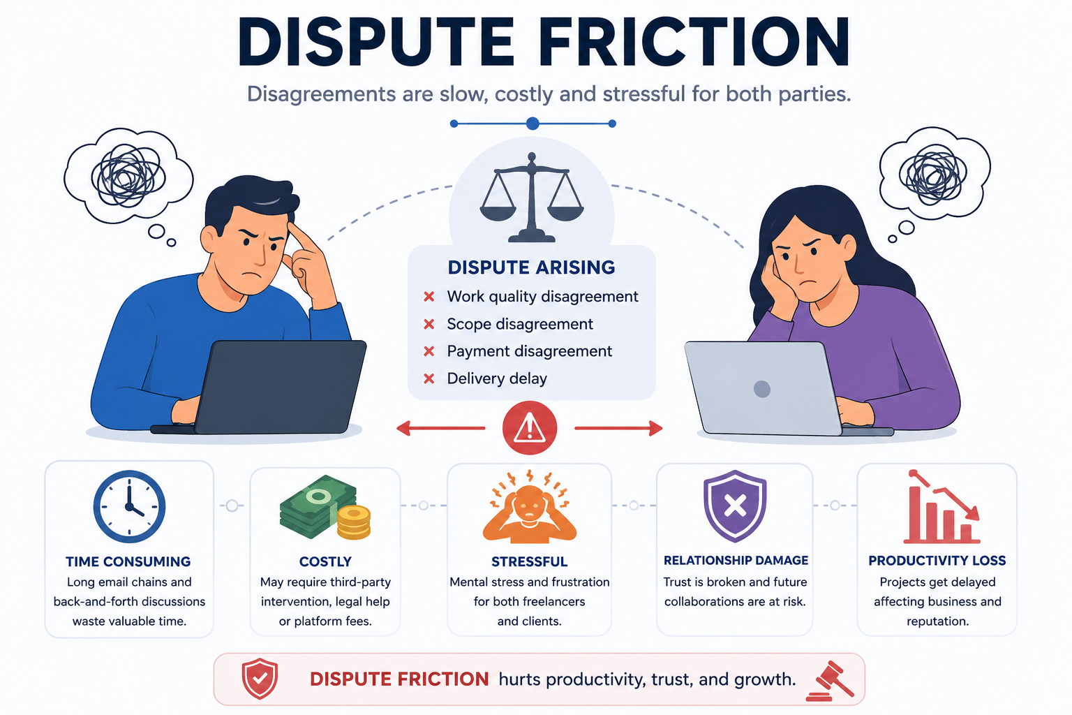
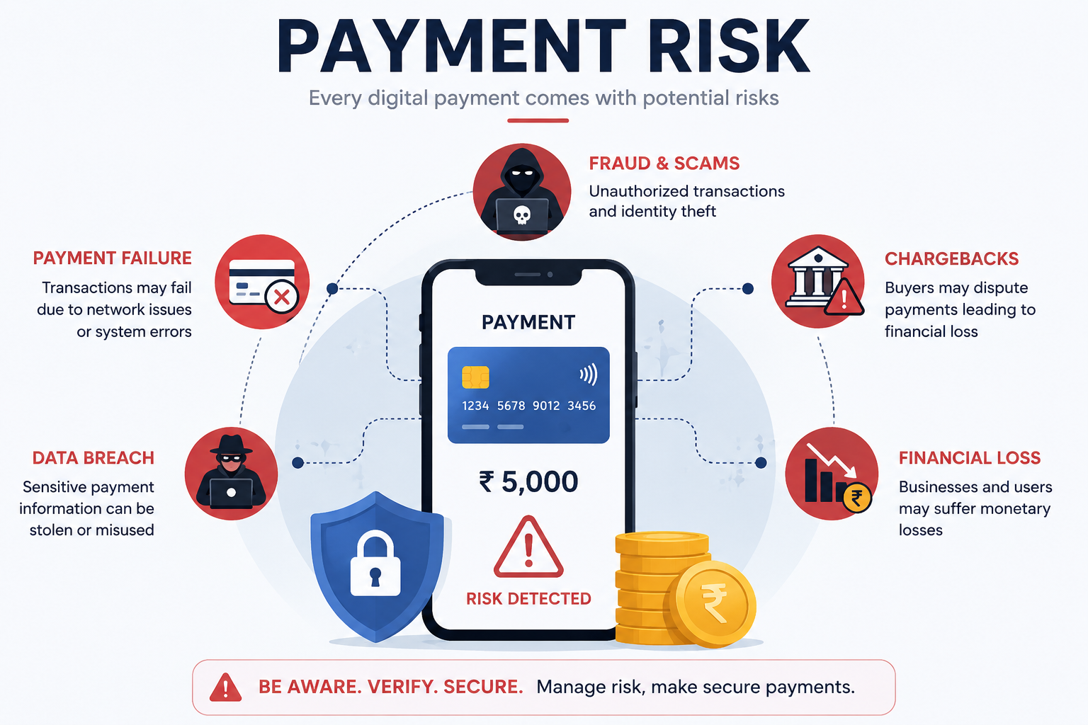
02
Problem Statement
Freelance work often depends on trust between strangers, while payment and dispute handling remain centralized.
PAYMENT RISK
CONTRACT AMBIGUITY
DISPUTE FRICTION
Clients may delay, reduce or withhold payment after work is completed.
Freelancers have limited leverage once deliverables are submitted.
Terms, milestones, revisions and acceptance criteria are often scattered across chats, documents and platforms.
Centralized platforms can control funds and decisions, while dispute evidence may be incomplete or difficult to verify.
CORE GAP
No shared, tamper-evident layer connecting contract terms → milestone evidence → escrow → release.
CHAIN TRUST • Blockchain-Based Freelance Contract & Payment Escrow
2

Slide 3
03
Proposed Solution
CHAIN TRUST creates a programmable trust layer for freelance contracts and milestone payments.
1
2
3
4
5
CREATE
LOCK
DELIVER
VERIFY
RELEASE
Client defines scope,
price & milestones
Funds are placed
in smart escrow
Freelancer submits
work + proof
Client accepts or
opens dispute
Smart contract pays
freelancer
KEY IDEA
The smart contract enforces the agreed workflow instead of relying only on platform promises.
CHAIN TRUST • Blockchain-Based Freelance Contract & Payment Escrow
3

Slide 4
04
Innovation & USP
A decentralized escrow workflow designed specifically around freelance milestones.
Programmable Escrow
Milestone-Based Contracts
Proof of Delivery
Funds move only when predefined conditions are satisfied.
Every milestone stores amount, deadline and acceptance criteria.
File hashes / evidence references make submitted work verifiable.
Transparent Disputes
Reduced Counterparty Risk
Platform-Agnostic Layer
Dispute events and decisions are recorded with auditable timestamps.
Neither party needs to fully trust the other before starting work.
Can be integrated with web/mobile freelance marketplaces.
USP
Contract + evidence + escrow + dispute trail in one tamper-evident workflow.
CHAIN TRUST • Blockchain-Based Freelance Contract & Payment Escrow
4

Slide 5
05
System Architecture
Hybrid architecture: keep sensitive files off-chain while anchoring proofs and contract state on-chain.
USER LAYER
Client • Freelancer • Admin / Arbitrator
ON-CHAIN
• Contract state
• Milestone status
• Payment events
• File hashes
• Dispute records
APPLICATION LAYER
Web / Mobile UI • Wallet • Notifications • Dashboard
SMART CONTRACT LAYER
Contract creation • Escrow • Milestones • Release • Dispute
OFF-CHAIN
• Large files
• Private metadata
• Encrypted artifacts
BLOCKCHAIN LAYER
Transactions • Events • Hashes • Ownership / audit trail
OFF-CHAIN STORAGE
Encrypted files • Documents • Delivery artifacts
CHAIN TRUST • Blockchain-Based Freelance Contract & Payment Escrow
5

Slide 6
06
End-to-End Workflow
The contract becomes the single source of truth for milestones, evidence and payments.
CLIENT
SMART
CONTRACT
FREELANCER
Post Job
Accept Contract
Fund Escrow
Submit Delivery
Approve / Dispute
Scope + milestones
Terms locked
Amount locked
Hash + evidence
Decision
AUTO-RELEASE / REFUND
On approval → pay freelancer | On valid dispute → route to resolution
All major actions emit blockchain events for auditability.
CHAIN TRUST • Blockchain-Based Freelance Contract & Payment Escrow
6

Slide 7
07
Technology Stack
Suggested stack for a working hackathon prototype; components can be swapped based on team expertise.
Frontend
Backend
Blockchain
React / Next.js
Responsive dashboard
Node.js / Express
REST APIs + auth
Ethereum-compatible test net
Solidity smart contracts
Wallet
Storage
Database
MetaMask / Wallet Connect
Transaction signing
IPFS or encrypted cloud
Hash anchored on-chain
PostgreSQL / MongoDB
User & analytics data
Prototype principle: keep blockchain transactions minimal; store large/private content off-chain and anchor integrity proofs.
CHAIN TRUST • Blockchain-Based Freelance Contract & Payment Escrow
7

Slide 8
08
Feasibility & Security
Technical Feasibility
Cost Efficiency
Use established EVM-compatible chains, Solidity and common wallet integrations.
Testnet deployment for demo; optimize on-chain data and use off-chain storage.
Security
Privacy
Role-based access, signed transactions, reentrancy protection and contract validation.
Do not store raw private files on-chain; store encrypted artifacts or content hashes.
Dispute Safety
Scalability
Freeze affected milestone funds while a defined dispute process is active.
Separate UI/API, blockchain service and storage so each layer can scale independently.
CHAIN TRUST • Blockchain-Based Freelance Contract & Payment Escrow
8

Slide 9



09
Impact & Benefits
Builds confidence for both sides of the freelance marketplace.
FREELANCERS
CLIENTS
PLATFORMS
• Faster, rules-based payment
• Evidence of delivery
• Reduced non-payment risk
• Portable contract history
• Funds released only on conditions
• Clear milestones & acceptance
• Traceable delivery evidence
• Lower platform dependency
• Lower dispute workload
• Transparent audit trail
• Programmable marketplace rules
• New trust layer for global work
EXPECTED OUTCOME
Higher trust • fewer payment disputes • verifiable milestones • stronger digital contract accountability
CHAIN TRUST • Blockchain-Based Freelance Contract & Payment Escrow
9

Slide 10

10
Future Scope
FUTURE SCOPE
• AI-assisted contract risk detection
• Reputation score based on verified work history
• Multi-chain / cross-border settlement
• DAO or third-party arbitration
• Stablecoin support where legally appropriate
• Mobile app + platform APIs
• Analytics for dispute and delivery patterns
ROADMAP
Pilot marketplace → Multi-platform integration → Global trust infrastructure
CHAIN TRUST • Blockchain-Based Freelance Contract & Payment Escrow
10

Slide 11
11
Why Chain Trust?
One clear proposition for the jury: make freelance agreements enforceable, transparent and easier to trust.
B1
B2
B3
B4
TAMPER-EVIDENT
PROGRAMMABLE
FAIRER
SCALABLE
Contract and milestone events can be independently verified.
Escrow rules automate payment conditions.
Both parties see the same milestone state and evidence trail.
Built as a modular trust layer.
CHAIN TRUST
From agreement to delivery to payment — every critical step has a verifiable digital trail.
Thank You • Questions
CHAIN TRUST • Blockchain-Based Freelance Contract & Payment Escrow
11

